Slide 2
Ecological Economics in Higher Education
A study on the state of the art of ecological economics education and the challenges and opportunities for its development
13-12-2022
Janne Mercedes Prinsen

Slide 3
Table of Contents
Motivation and problem statement
Aims and research questions
Background and theory
Methods
Results
Discussion
Limitations
Conclusions
Future research
References

Slide 4
Motivation and Problem Statement
Need for reforming economics theory, practice, and education
Role of education in achieving sustainability
Little research on ecological economics in (higher) education
Decker et al. 2019; Dube, 2021; Gowdy & Erickson, 2005; IPBES, 2019; Daly & Farley, 2011

Slide 5
Aims and Research Questions
Assess the state of the art of ecological economics in higher education and address challenges and opportunities for its further development
Where is ecological economics taught and what are the main trends and geographical patterns?
What are the core concepts, theories, and methods taught in ecological economics education?
What elements do ecological economists consider most relevant for an ecological economics curriculum?
What are the challenges and opportunities for future development in the field in higher education?
I hope that this study can serve as a basis for articulating the field further in higher education!

Slide 6
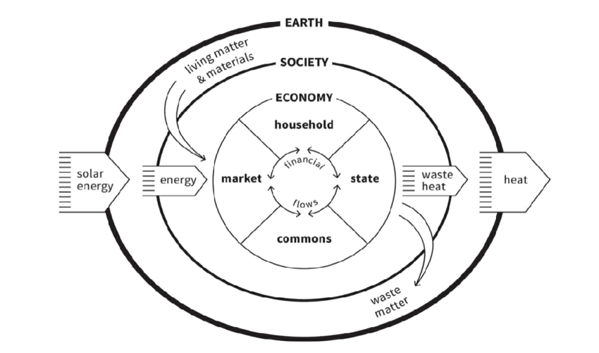
Background and Theory (1)
Core propositions of ecological economics:
Economic scale, embeddedness, biophysical limits to growth, social equity, (re)distribution, coevolution, fundamental uncertainty, inter- and transdisciplinarity, limited substitutability of capital, valuation of nature
Proops, 1989; Daly, 2008; Martínez-Alier & Muradian, 2015; Costanza, 1991; Costanza, 1996; O’Neill, 1997; Gual & Norgaard, 2010; Daly, 2007; Kallis & Norgaard, 2010
Debates within the field:
Valuation of nature, ontological framing of biophysical limits, population growth, monetary valuation, pluralism and trandisciplinarity, framings of human-nature relationships, substitutability of natural and manufactured capital
Embedded Economy. Diagram by Marcia Mihotich. Copyright © 2017 Kate Raworth.

Slide 7
Background and Theory (2)
Movement for change in economics theory, practice, and education
Rethinking Economics & Curriculum Open-Access Resources in Economics (CORE)
Limited literature on ecological economics in (higher) education

Slide 8
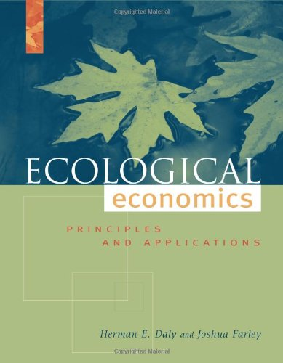
A Multi-Method Approach
A systematic and manual search for programs, courses, and teaching materials
A systematic search for books on ecological economics
Semi-structured interviews

Slide 9
Results – Geographical Distribution & Trends
14 full degrees (12 active)
72 courses
2 modules
7 summer schools
European and North American dominance
Only 1 bachelor’s degree
Mostly outside of economic faculties and departments (3/14 degrees and 12/72 courses)

Slide 11
Results – Concepts, Theories, Methods

Slide 13
Ideas for Curricula in Ecological Economics
Philosophy of science: critical realism & environmental ethics
History of economic thought & pluralist/heterodox economics
Inter- and transdisciplinarity
Tracks within a degree
The issue with mathematics in ecological economics
Teaching mainstream economics ideas

Slide 14
Results – Challenges and Opportunities
Main Challenges | Subtype of Challenges | Specific Challenges
Institutional | Finance and Funding | Faculty and department structure at universities Issues with interdisciplinary research and education Lack of inter- and intra- institutional collaboration
 | Structure and Culture at Universities | Issues with interdisciplinary research and education Dominance of mainstream economics at universities Lack of inter- and intra- institutional collaboration Educational home of ecological economics at universities
Political | Dominance of Mainstream Economics | Neoclassical economics dominance in business and government (the political climate)
 | Ecological Economics as too revolutionary | Lack of acceptance of ecological economics ideas
Internal | Scoping of Ecological Economics | Ecological economics as too broad Ecological economics not well known enough Lack of a positive vision for the future within ecological economics The extent to which ecological economics education should accommodate to the job market
 | Educational Challenges | Lack of good quality teaching materials Structure and contents of degree and courses Resource intensiveness of education Experience and expertise of the teacher Requirements for the programs Evaluation of students performance Students expectations Lack of inter/intra-institutional collaboration

Slide 15
Results – Challenges and Opportunities
Main Challenges | Subtype of Challenges | Specific Challenges
Institutional | Finance and Funding | Faculty and department structure at universities Issues with interdisciplinary research and education Lack of inter- and intra- institutional collaboration
 | Structure and Culture at Universities | Issues with interdisciplinary research and education Dominance of mainstream economics at universities Lack of inter- and intra- institutional collaboration Educational home of ecological economics at universities
Political | Dominance of Mainstream Economics | Neoclassical economics dominance in business and government (the political climate)
 | Ecological Economics as too revolutionary | Lack of acceptance of ecological economics ideas
Internal | Scoping of Ecological Economics | Ecological economics as too broad Ecological economics not well known enough Lack of a positive vision for the future within ecological economics The extent to which ecological economics education should accommodate to the job market
 | Educational Challenges | Lack of good quality teaching materials Structure and contents of degree and courses Resource intensiveness of education Experience and expertise of the teacher Requirements for the programs Evaluation of students performance Students expectations Lack of inter/intra-institutional collaboration
Main Opportunities | Subtype of Opportunities | Specific Opportunities
Institutional | Finance and Funding | Collaboration with other scholars in different faculties and departments Engage with academic politics
 | Structure and Culture at Universities | Create a widespread community of ecological economics in academics Engage with academic politics
Political | Dominance of Mainstream Economics | Create a widespread community of ecological economics in society Organize ecological economics career events Collaborate with local societies in educational activities
 | Ecological Economics as too revolutionary
Internal | Scoping of Ecological Economics | Provide different tracks within degrees
 | Educational | Increase use of alternative teaching materials Database for teaching styles and materials in ecological economics Organize longer high-quality summer schools Diversify modes of teaching Action-based education Focus on (practical) skills within ecological economics education

Slide 16
Discussion
Geographical Distribution & State of the Art in Ecological Economics Education
European and North American centered
Limited acceptance of ecological economics in economics departments
Room for development of undergraduate (and PhD) programs worldwide

Slide 17
Discussion
Geographical Distribution & State of the Art in Ecological Economics Education
Little consistency in teaching materials used
Inconsistency between core concepts in the field and what is present in education
Inconsistency between wishes of scholars and the education that exists
Need for a coherent set of core concepts and teaching materials

Slide 18
Discussion – Fundaments for Ecological Economics Education
Core values: diversity, critical thinking, creativity, collaboration
The importance of alternative modes of teaching
Contents of teaching:
Introductory and general courses in EE
History of economic thought
Heterdox economics
Philosophy of science and ethics
Research methods (qualitative, quantitative, interdisciplinairy)
Thesis project
Natural sciences course

Slide 19
Discussion – Stategies and Recommendations for Moving Forward
Institutional structure of universities academic politics and engaging with activist organizations
Action-Based Education
Alternative ways of teaching
Focus on skills in education issues with adapting to wishes of the market
Role of International and Regional Societies for Ecological Economics
Database of educational materials
Focus on education in strategies and conferences

Slide 20
Conclusions
Main challenges
Institutional; political; and internal
Main opportunities
Increase use of alternative teaching materials and styles of teaching
Database of educational materials
Tracks within a master’s degree
Action-Based education and engaging with local society; creating partnerships
Engage in academic politics
Room for ecological economics to establish more degrees and courses worldwide
Inconsistencies in education reflective of tensions and disagreements within the field

Slide 21
Future Research
Experiences of students in ecological economics education
Survey amongst students and teachers in the field
Bibliographic analysis of teaching materials

Slide 22
References
Beer, D. L. (2018). Teaching and learning ecosystem assessment and valuation. Ecological economics, 146: 425-434. doi: 10.1016/j.ecolecon.2017.12.014.
Core Economics Education (2021). What is core? Available at: core-econ.org/about/ (Accessed at: 22.03.2021).
Eberhardson, M., & Friman, E. (2001). Challenges and Opportunities in Teaching Ecological Economics. Mälardalen University, Dept of Business Studies and Informatics.
Gáspár, J., Hideg, É., & Köves, A. (2021). Future in the Present: Participatory Futures Research Methods in Economic Higher Education–The Development of Future Competencies. Journal of Futures Studies, 26 (2): 1-18. doi: 10.6531/JFS.202112_26(2).0001.
Kallis, G. (2007). Socio-environmental co-evolution: some ideas for an analytical approach. The International Journal of Sustainable Development & World Ecology, 14 (1): 4-13. doi: 10.1080/13504500709469703.

Slide 23
Kiss, G., Veress, T., & Köves, A. (2021). Learning responsibility-teaching sustainability. experiential and transformative learning in a business school. Vezetéstudomány-Budapest Management Review, 51 (7): 18-29. doi: 10.14267/VEZTUD.2021.07.03.
Polimeni, J. M. (2004). Graduate education in ecological economics. Ecological economics, 51 (3-4): 287-293. doi: 10.1016/j.ecolecon.2004.09.009.
Røpke, I. (2020). Econ 101—In need of a sustainability transition. Ecological Economics, 169: 106515. doi: 10.1016/j.ecolecon.2019.106515.
Rethinking Economics (2021). Why Rethink Economics. Available at: https://www.rethinkeconomics.org/get-involved/why-rethink-economics/ (Accessed: 08.03.2021).
Santone, S. (2013). Ecological Economics Education. In McKeown, R. & Nolet, V. (ed) Schooling for Sustainable Development in Canada and the United States. Springer, Dordrecht. https://doi.org/10.1007/978-94-007-4273-4_11.

Slide 24
Decker, S., Elsner, W., & Flechtner, S. (Eds.). (2019). Principles and Pluralist Approaches in Teaching Economics: Towards a Transformative Science (Vol. 41). Routledge.
Dube, B. (2021). Why cross and mix disciplines and methodologies?: Multiple meanings of Interdisciplinarity and pluralism in ecological economics. Ecological Economics, 179: 106827. doi: 10.1016/j.ecolecon.2020.106827.
Gowdy, J., & Erickson, J. D. (2005). The approach of ecological economics. Cambridge Journal of economics, 29 (2): 207-222. doi: 10.1093/cje/bei033.
IPBES. (2019). Global assessment report of the Intergovernmental Science-Policy Platform on Biodiversity and Ecosystem Services, Brondízio, E. S., Settele, J., Díaz, S., Ngo, H. T. (ed). IPBES secretariat, Bonn, Germany. ISBN: 978-3-947851-20-1.
Daly, H. E., & Farley, J. (2011). Ecological economics: principles and applications. Island press.
O’neill, J. (1997). Value pluralism, incommensurability and institutions. In Foster, J. (ed) Valuing nature?, pp. 87-100. Routledge.

Slide 25
Daly, H. (2008). Ecological economics and sustainable development: Selected essays. New York, NY, USA: Edward Elgar.
Proops, J. L. (1989). Ecological economics: rationale and problem areas. Ecological economics, 1 (1): 59-76. doi: 10.1016/0921-8009(89)90024-4.
Martínez-Alier, J., & Muradian, R. (2015). Taking stock: the keystones of ecological economics. In Martínez-Alier, J. & Muradian, R. (ed.) Handbook of Ecological Economics, pp. 1-25. Edward Elgar Publishing.
Costanza, R. (Ed.), 1991. Ecological economics: the science and management of sustainability. Columbia University Press, New York.
Gual, M. A., & Norgaard, R. B. (2010). Bridging ecological and social systems coevolution: A review and proposal. Ecological Economics, 69 (4): 707-717. doi: 10.1016/j.ecolecon.2008.07.020.
Daly, H. E. (2007). Ecological economics and sustainable development. Edward Elgar Publishing.
Kallis, G., & Norgaard, R. B. (2010). Coevolutionary ecological economics. Ecological economics, 69 (4): 690-699. doi: 10.1016/j.ecolecon.2009.09.017.

Slide 26
Discussion Questions
If you could design a curriculum for a course or degree in Ecological Economics, what would it look like?
How do you think action-based education can take shape at you institution(s)? (Do you believe action based-education to be relevant for ecological economics?)
What are steps that the ANZSEE can take to promote further development of ecological economics in higher education?

Slide 27
Thank you!

